Slide 1
Intermediate Code Generation
Lecture 18
Chapter 6
Rokan U. Faruqui
Associate Professor,
Dept of Computer Science and Engineering, University of Chittaong
Email: rokan@cu.ac.bd
Intermediate Code Generation

Slide 2


Slide 3
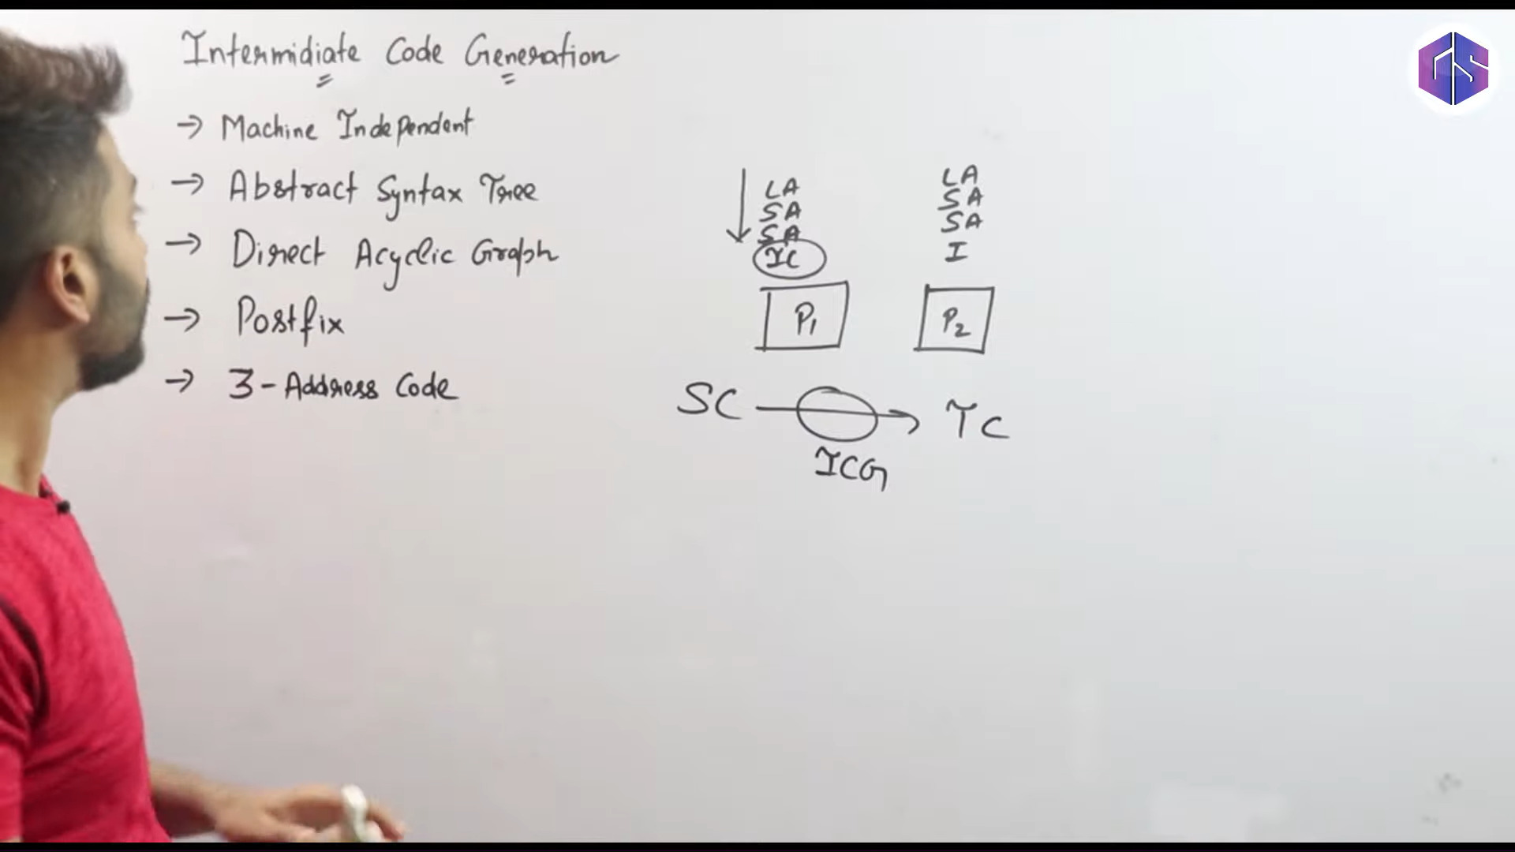

Slide 4
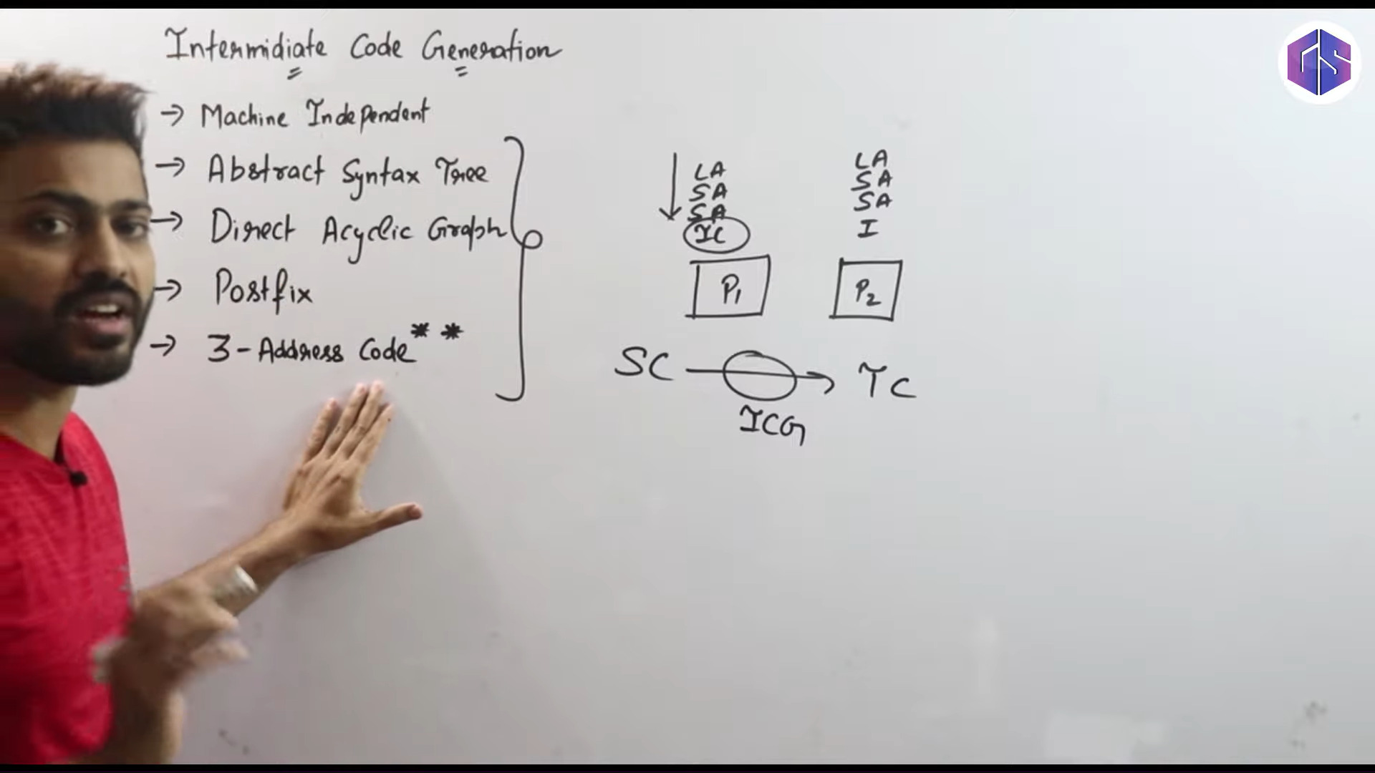

Slide 5
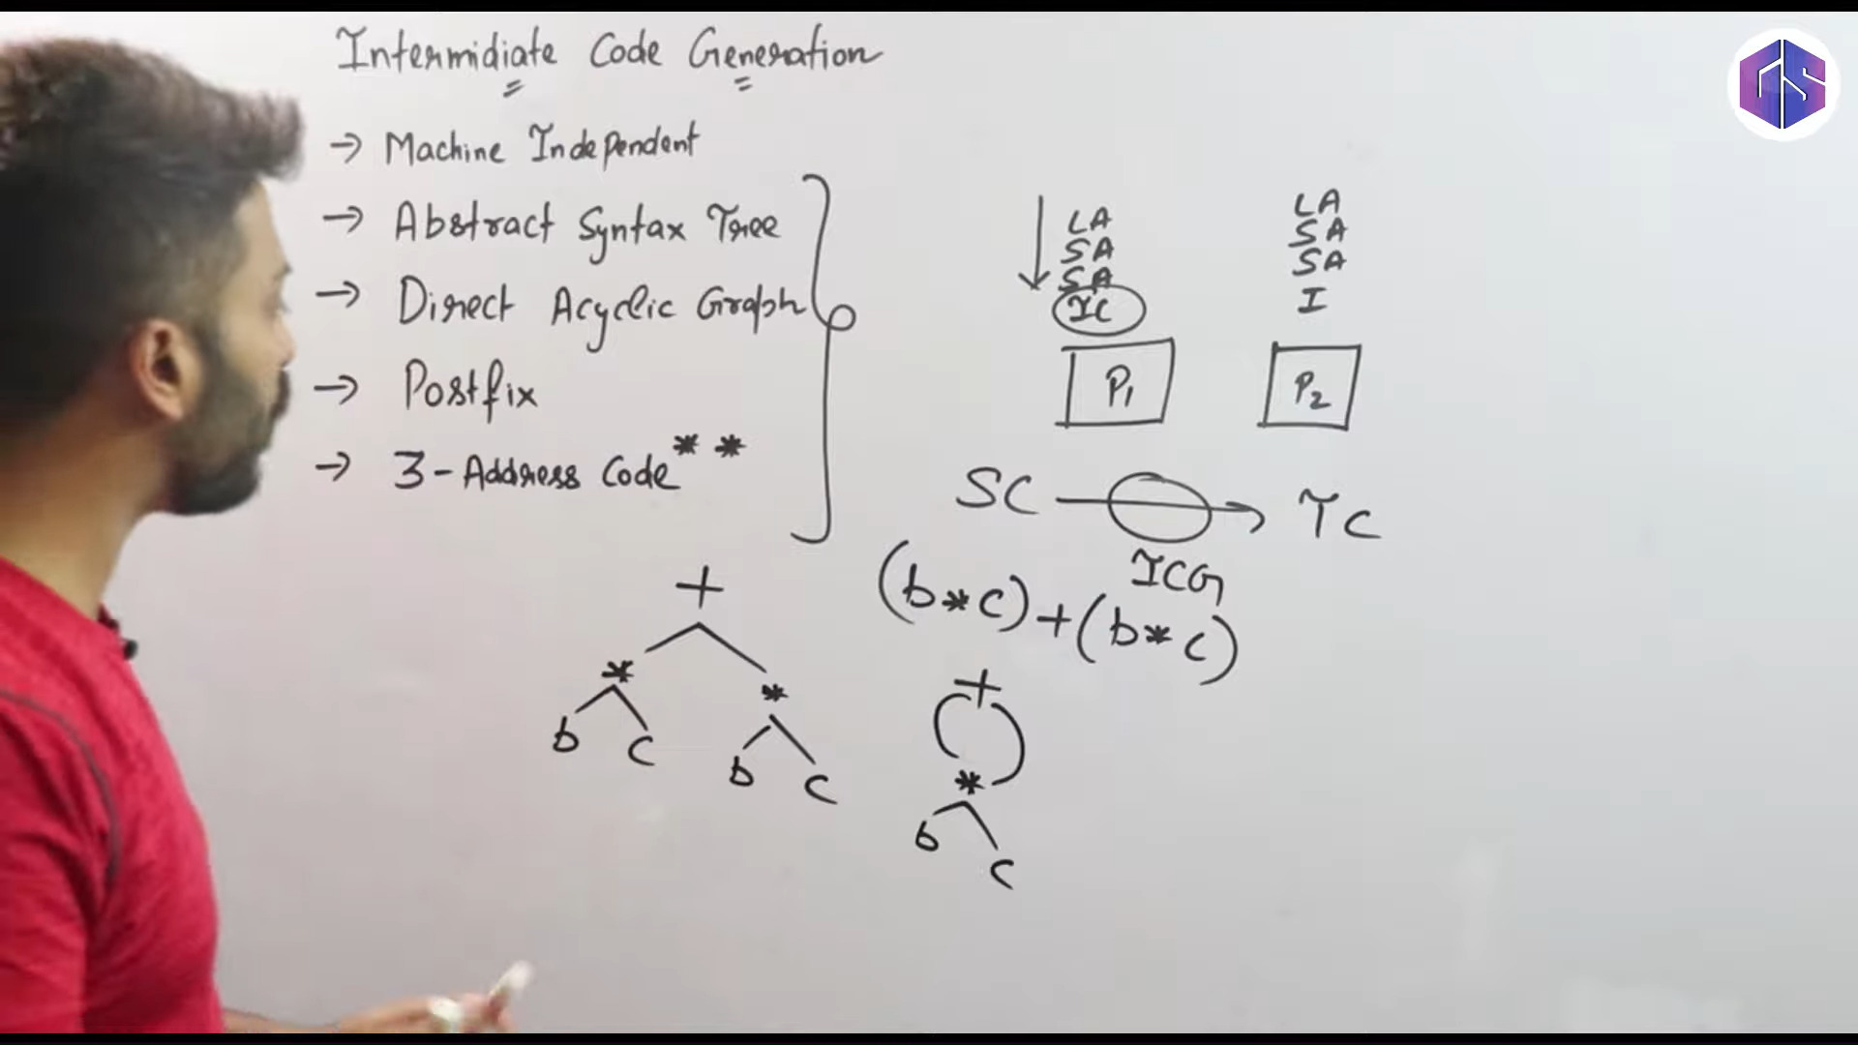

Slide 6
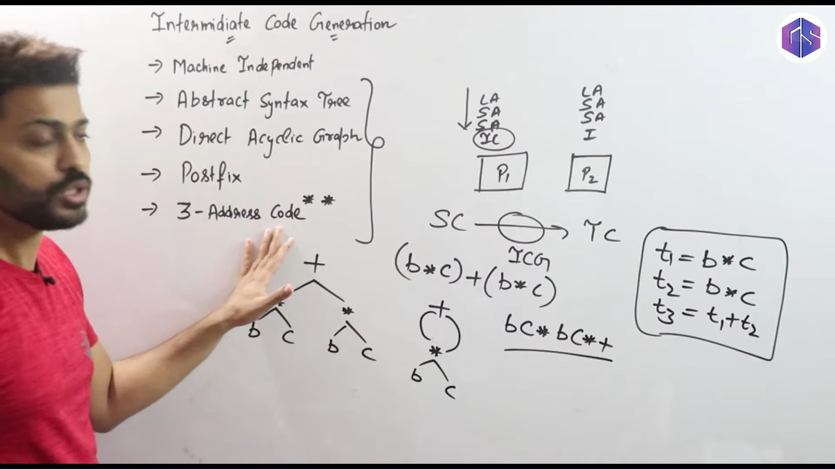

Slide 7
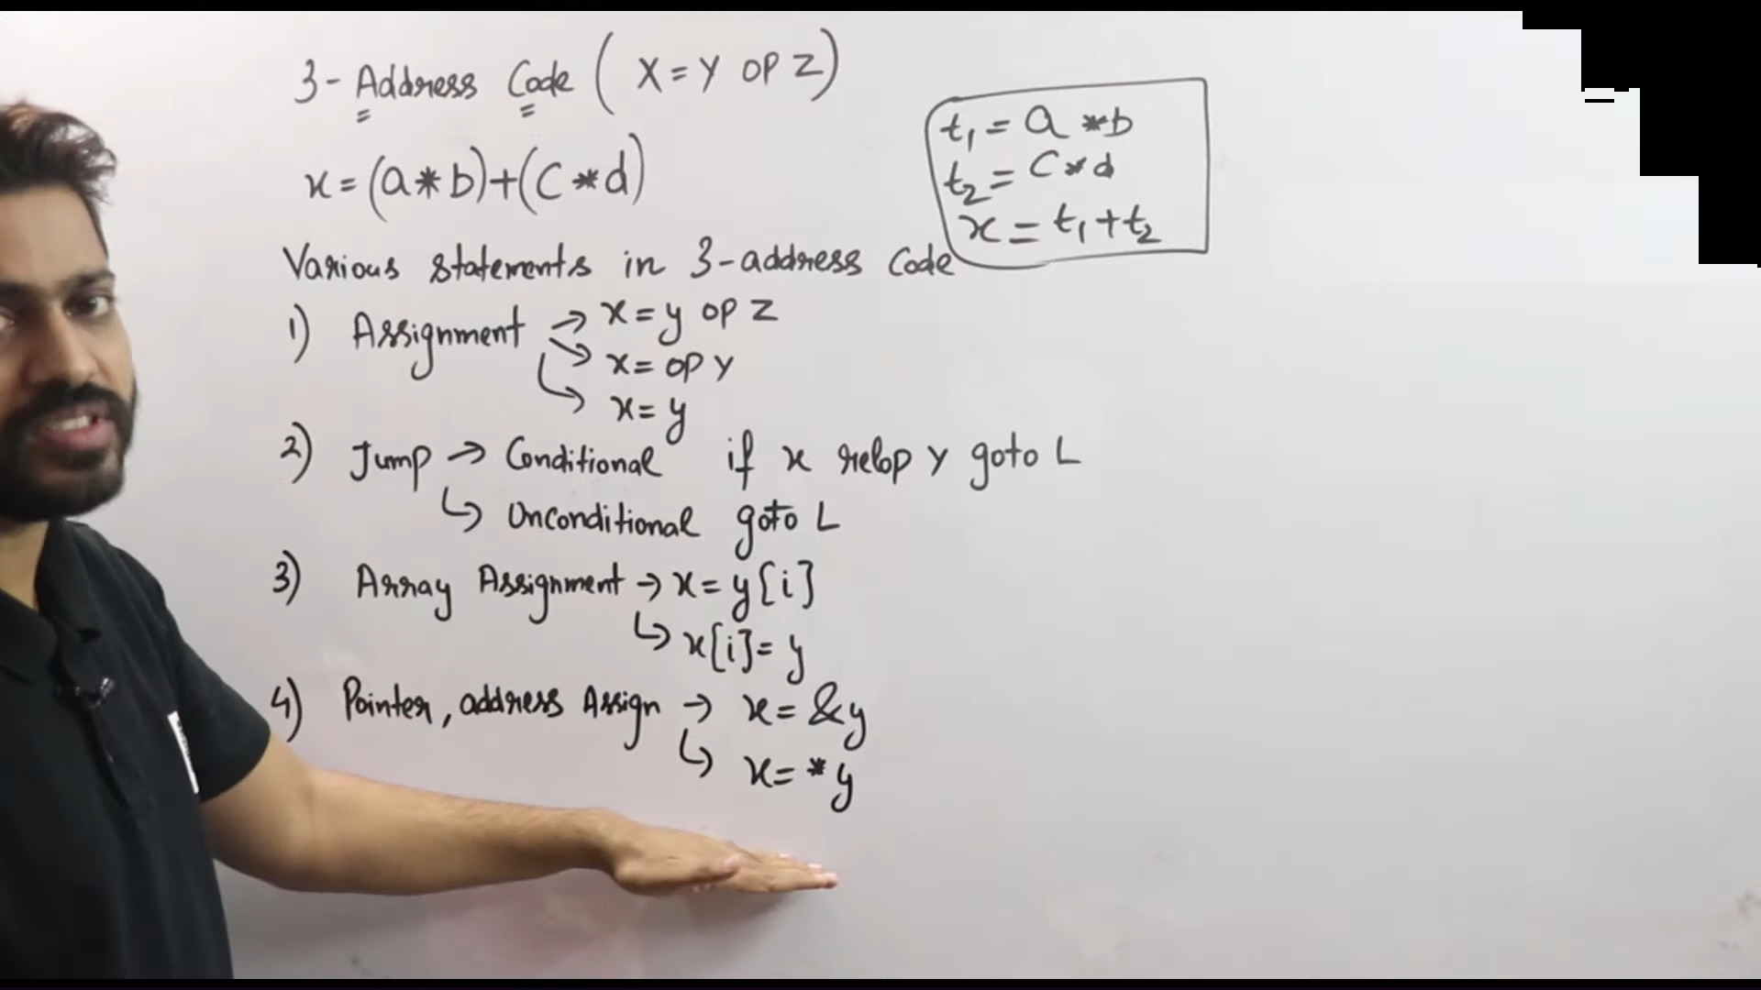

Slide 8
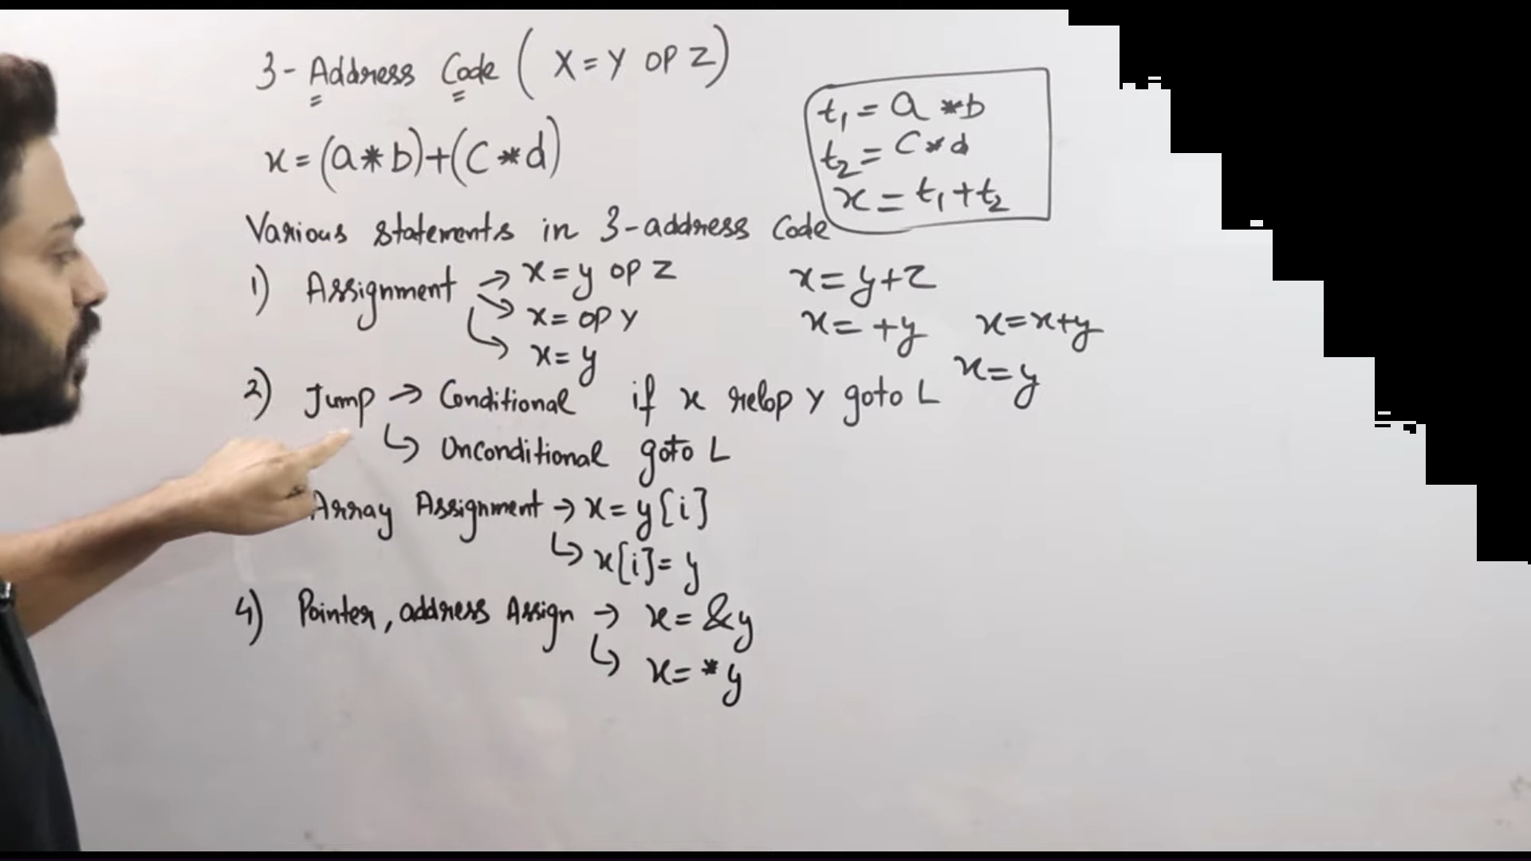

Slide 9
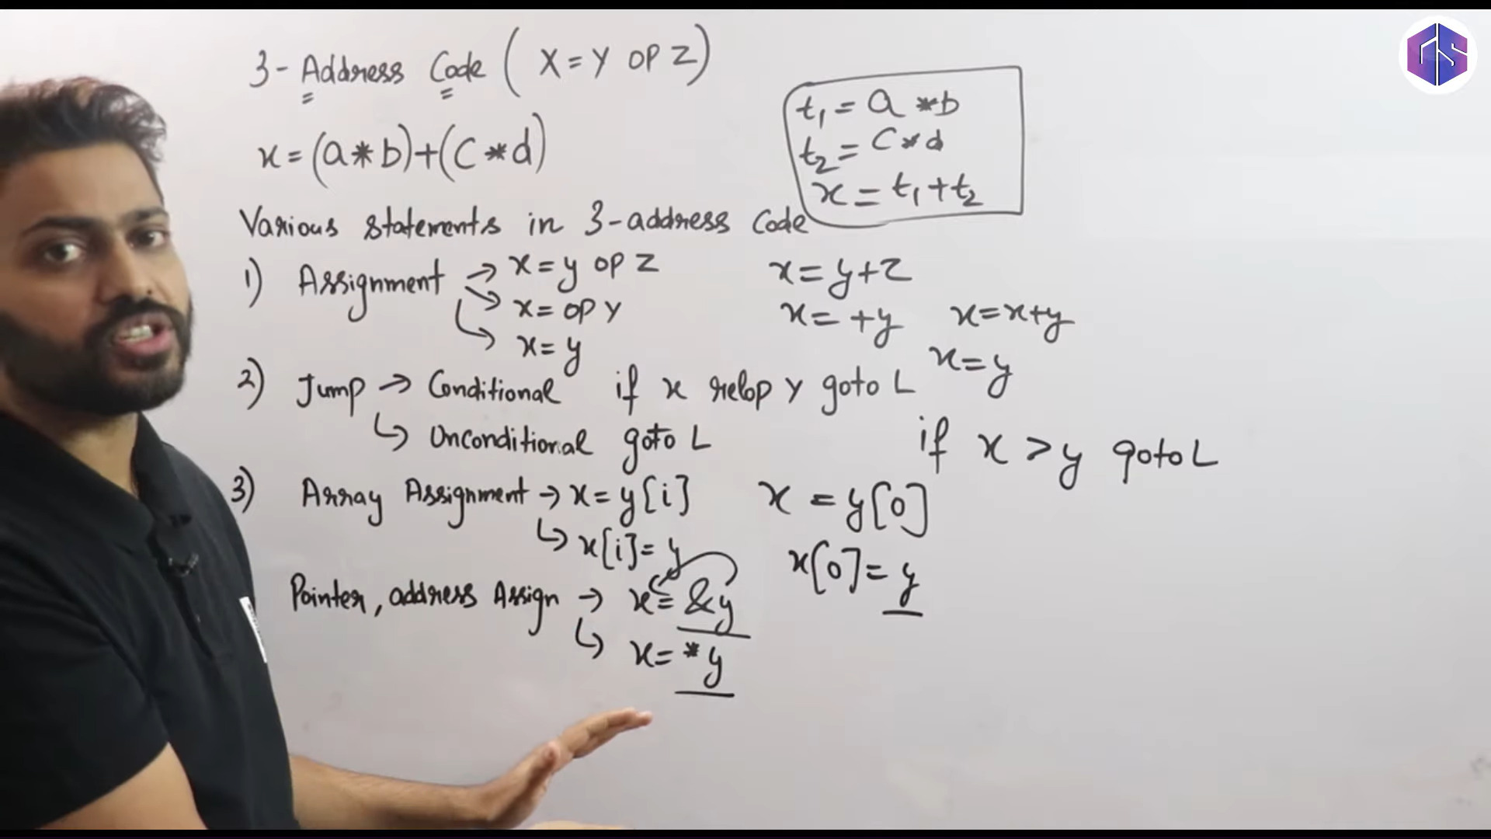

Slide 10


1
Variants of Syntax Trees
2
Three Address Code
Intermediate Code Generation

Slide 11
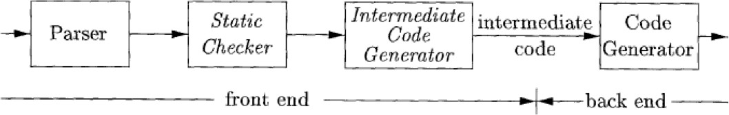
Introduction
Intermediate code is the interface between front end and back end in a compiler
Ideally the details of source language are confined to the front end and the details of target machines to the back end (a m*n model)
In this chapter we study intermediate representations, static type checking and intermediate code generation
print “Hello”;
c++ —>[compiler]—> .exe/asm/bytecode
Intermediate Code Generation

Slide 12
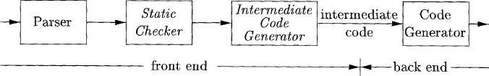

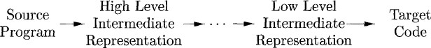
Introduction
Close to source language (e.g. syntax tree)
Close to machine langua
m x n compilers can be built by writing just m front ends and n back ends
Intermediate Code Generation

Slide 13
Introduction
semantic analysis
Includes:
Type checking
Any syntactic checks that remain after parsing (e.g. ensure break statement is enclosed within while-, for-, or switch statements).
Intermediate Code Generation

Slide 14


Outline
1
Variants of Syntax Trees
2
Three Address Code
Intermediate Code Generation

Slide 15
Variants of Syntax Trees
It is sometimes beneficial to crate a DAG instead of tree for Expressions.
This way we can easily show the common sub-expressions and then use that knowledge during code generation
Intermediate Code Generation

Slide 16
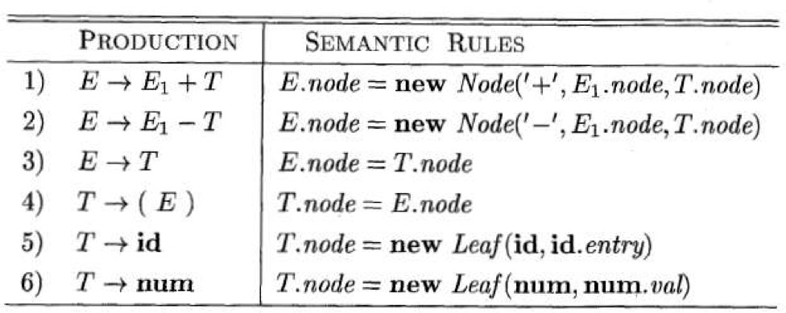
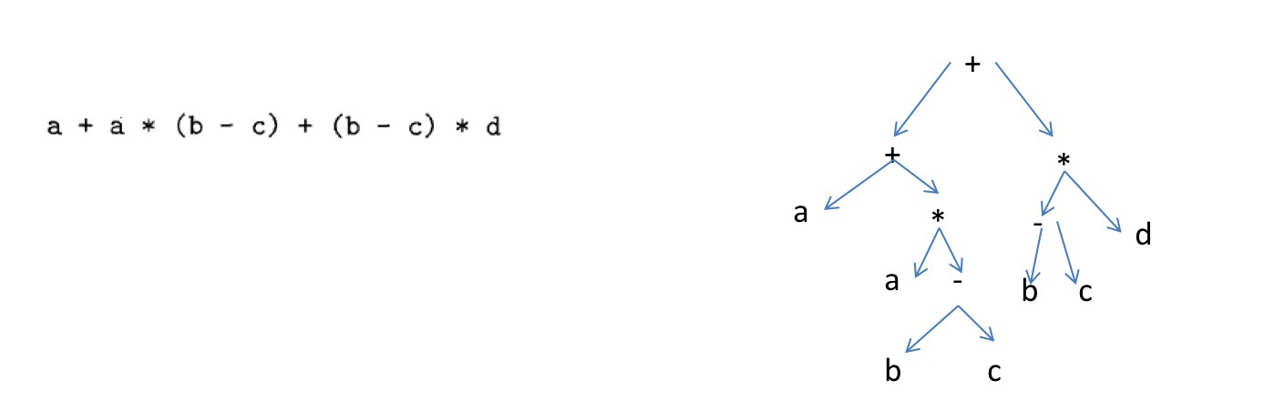
Syntax Tree
E.val = E1.val + T.val
Intermediate Code Generation

Slide 17


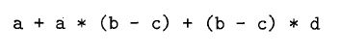

Syntax Tree
+
+
*
a
* -
d
a -
b c
b
c
Intermediate Code Generation

Slide 18


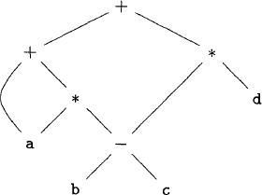
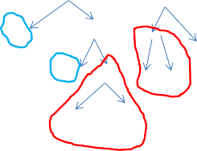
DAG
+
+
*
a
* -
d
a -
b c
b
c
Node can have more than
one parent
Directed Acyclic Graph (DAG):
More compact representation
Gives clues regarding generation of efficient code
Intermediate Code Generation

Slide 19
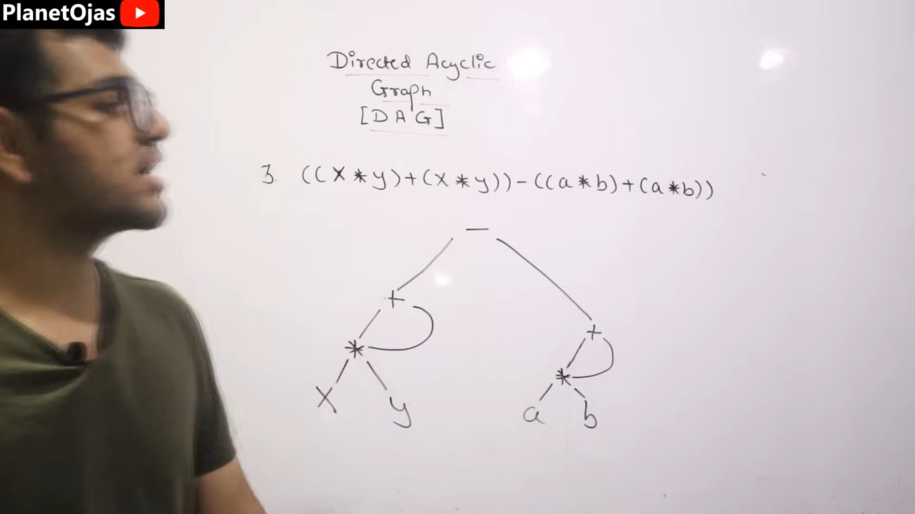

Slide 20
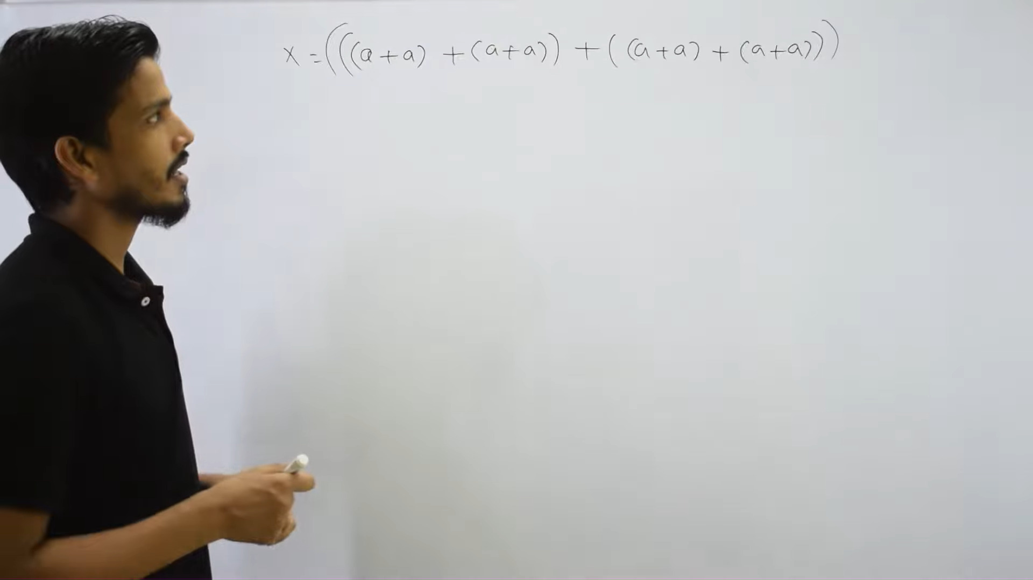

Slide 21
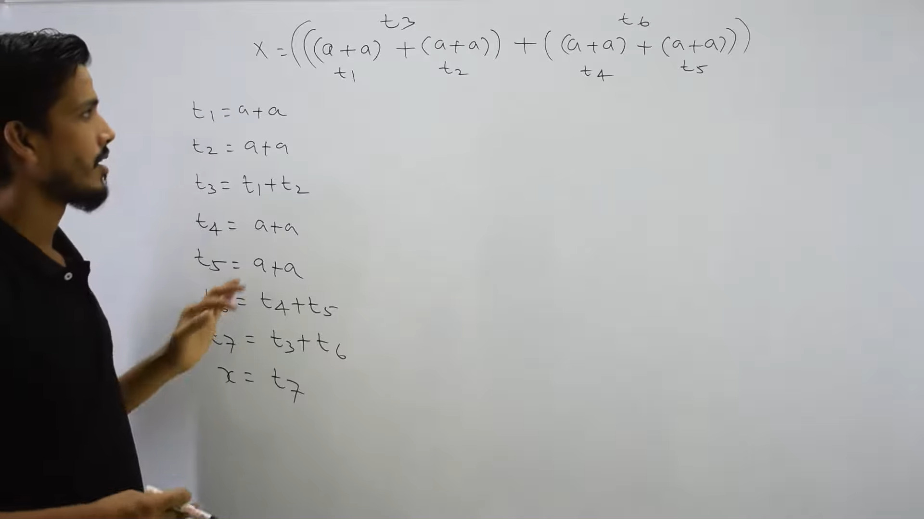

Slide 22
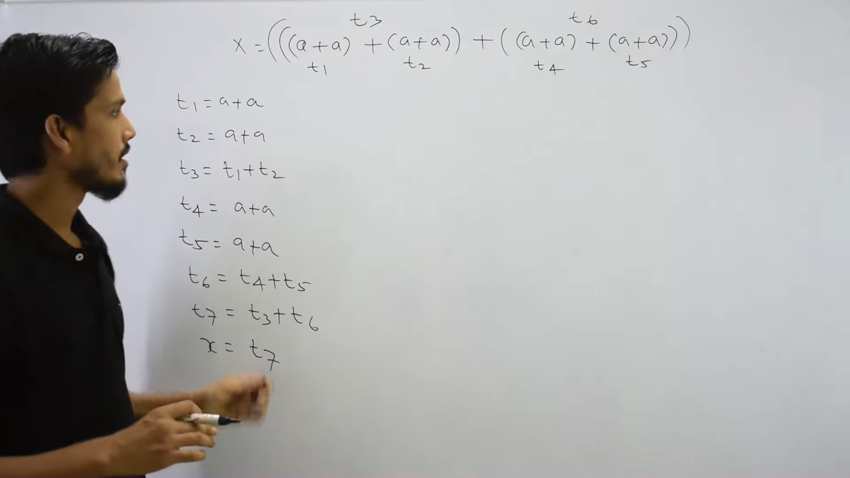

Slide 23
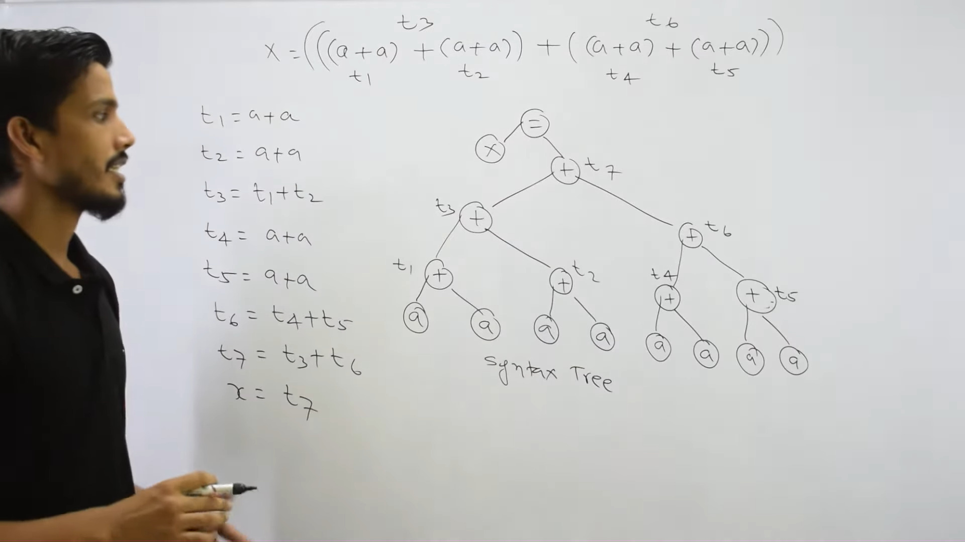

Slide 24
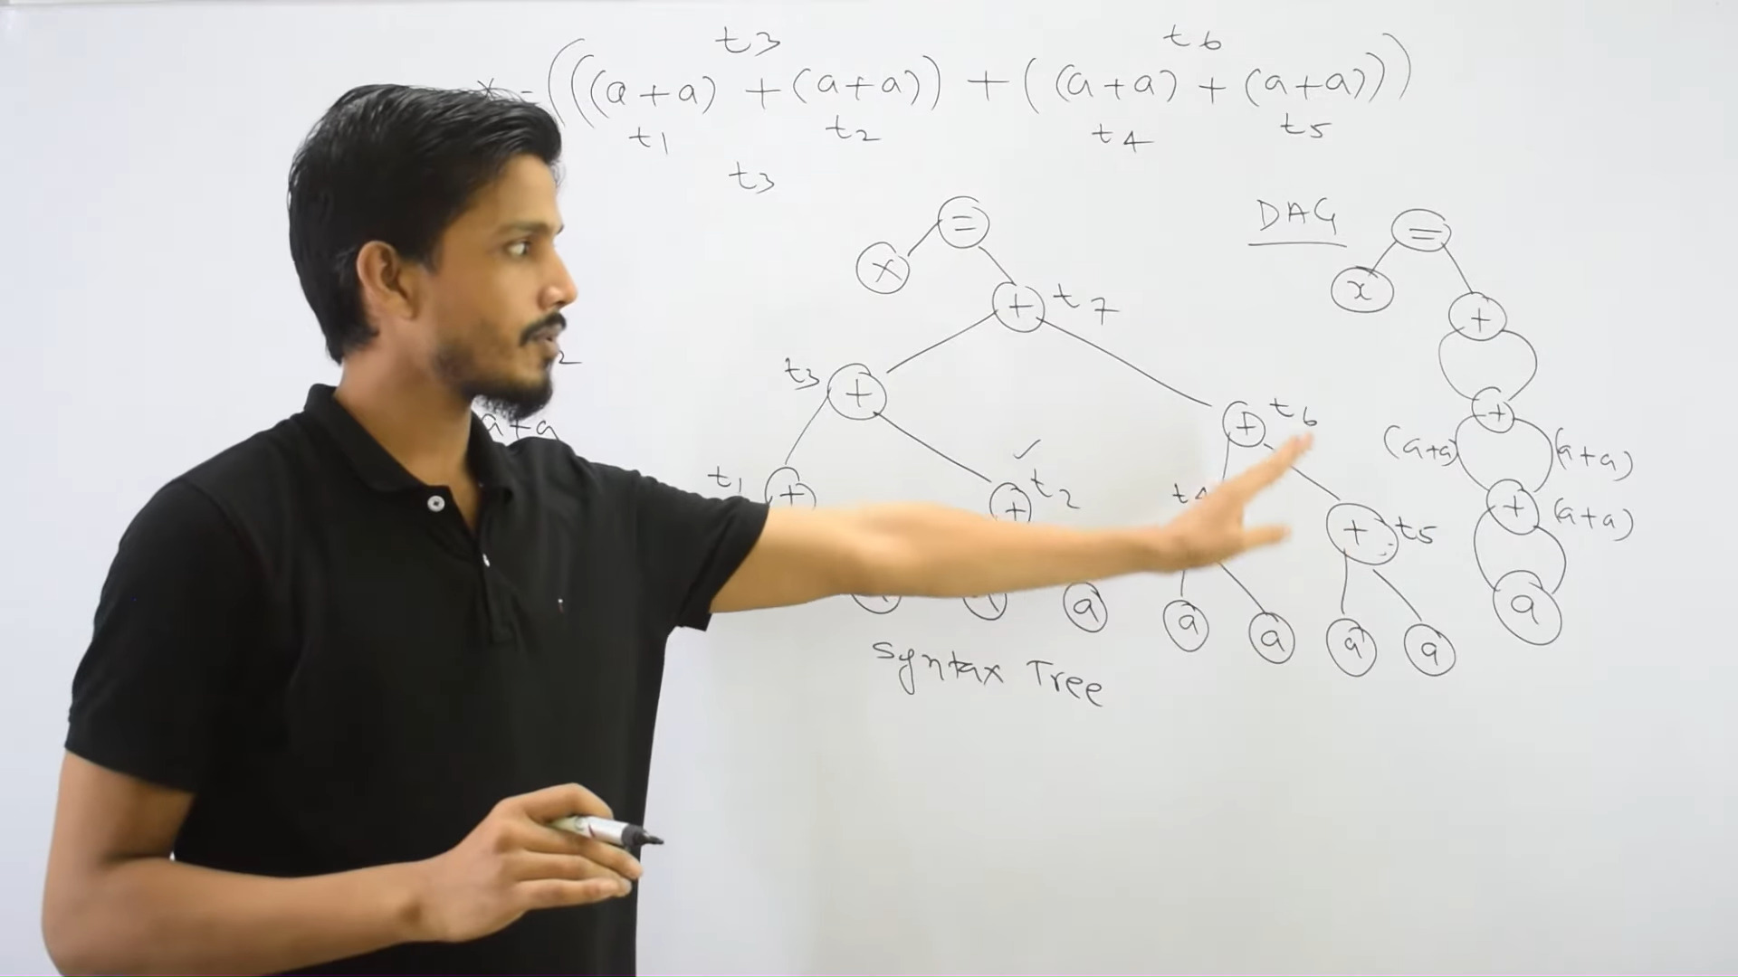

Slide 25
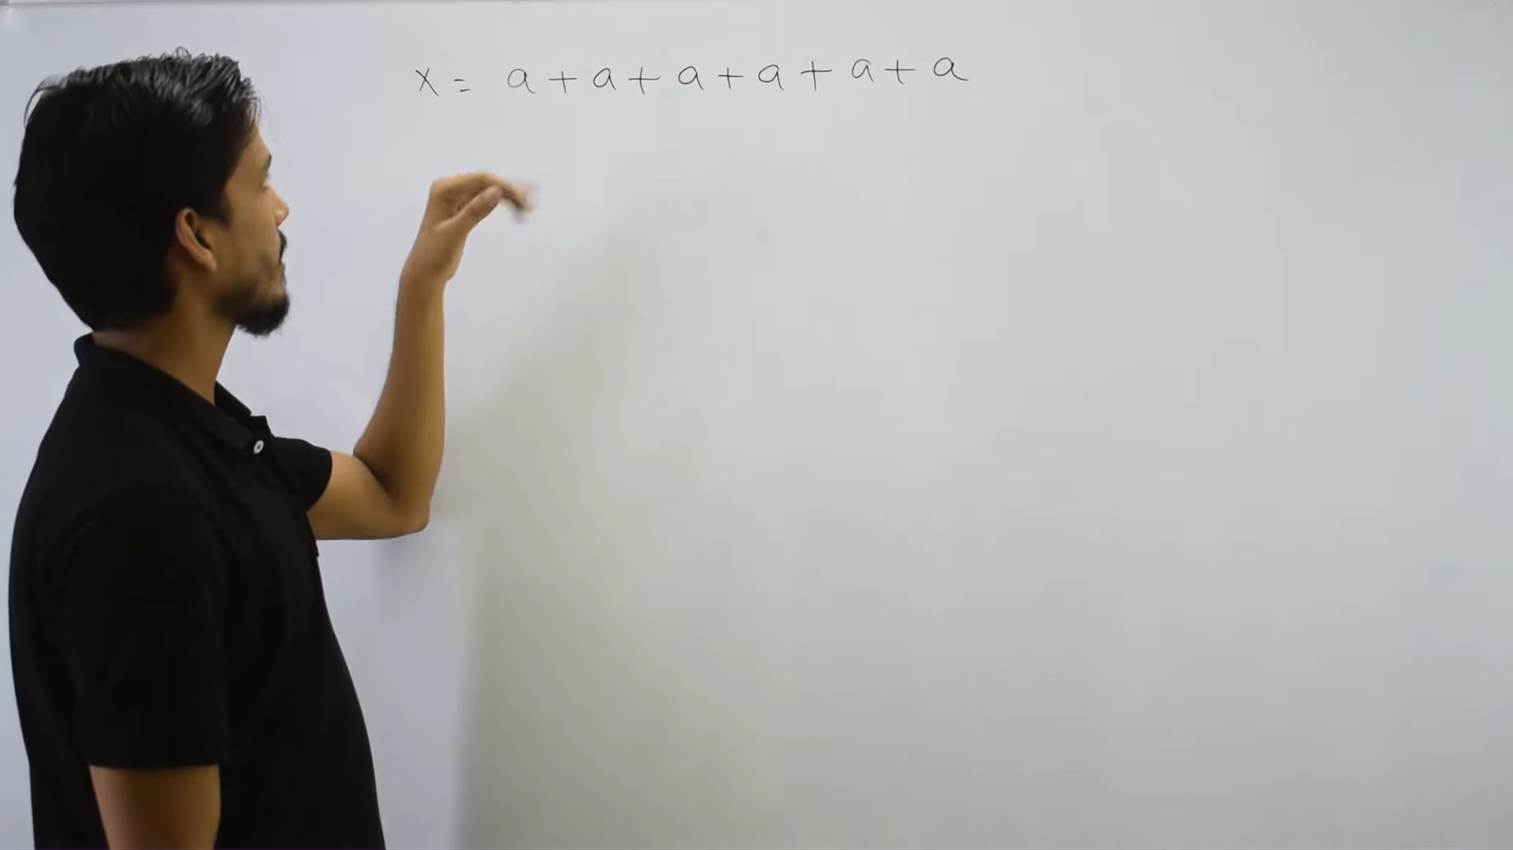

Slide 26
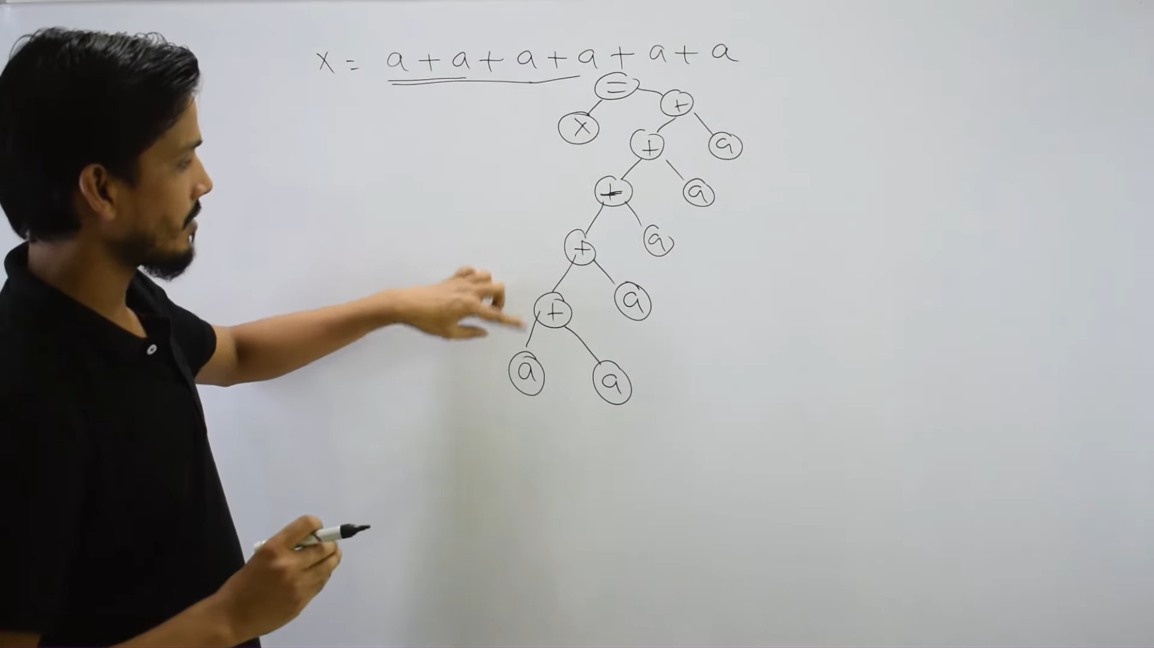

Slide 27
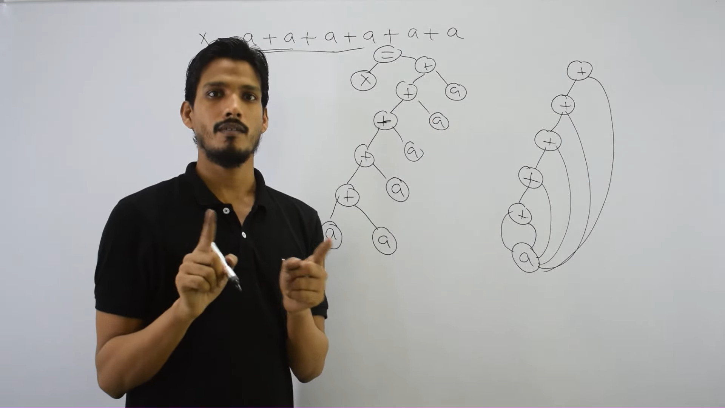

Slide 28
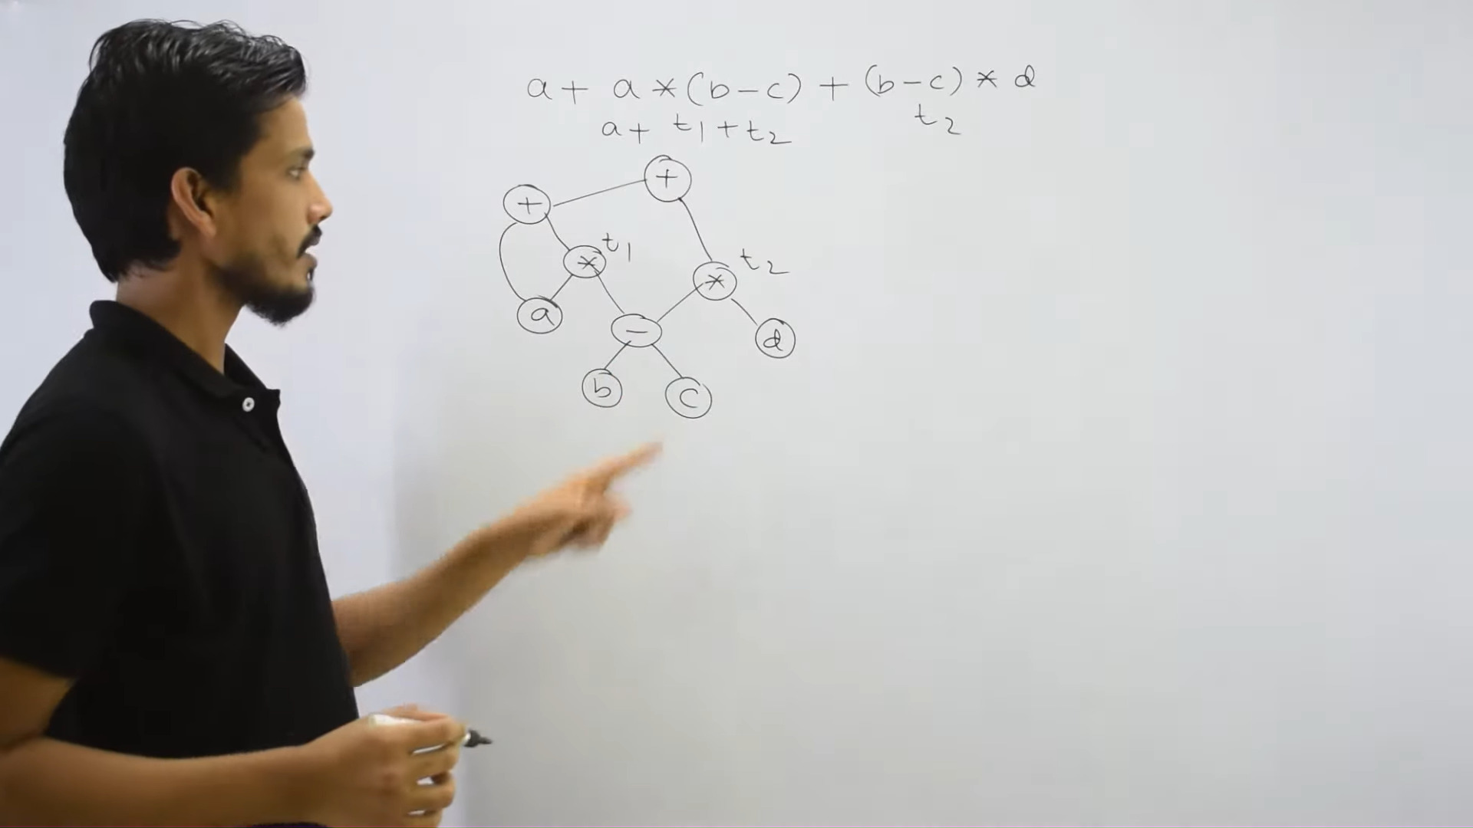

Slide 29
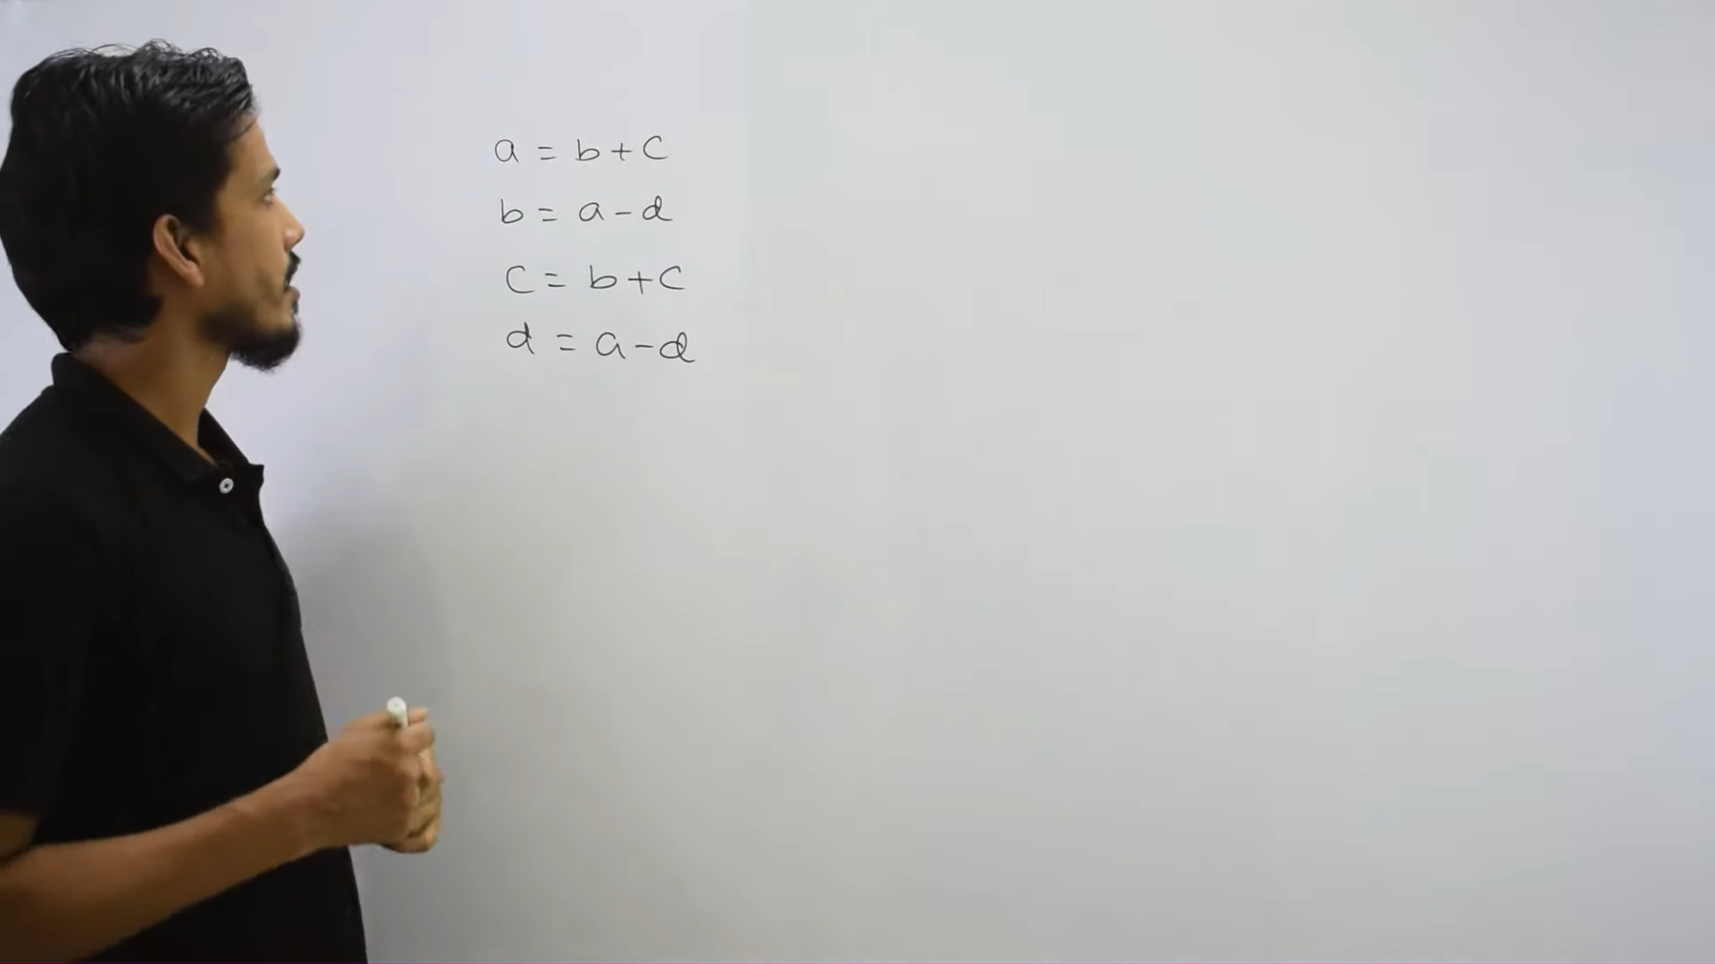

Slide 30
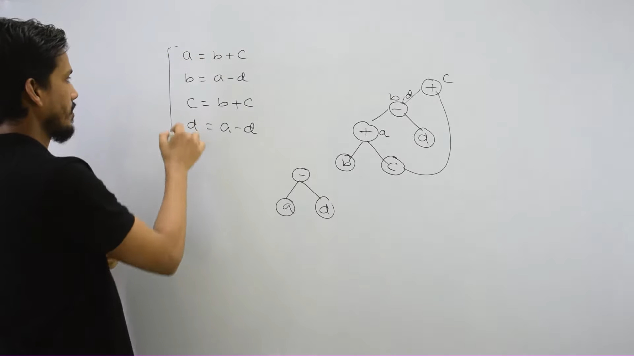

Slide 31
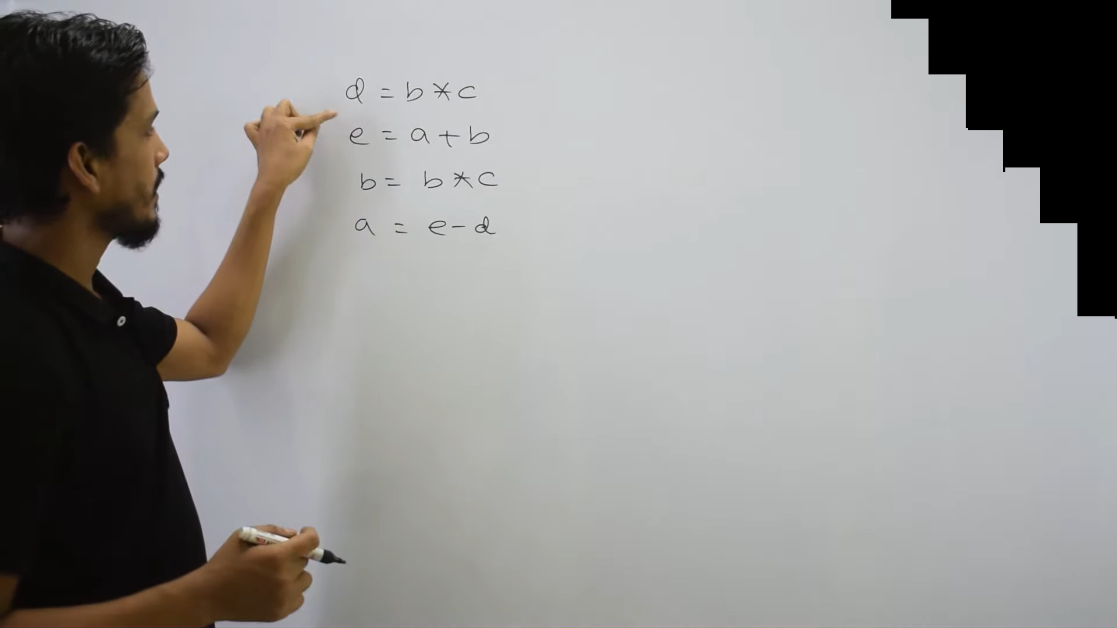

Slide 32
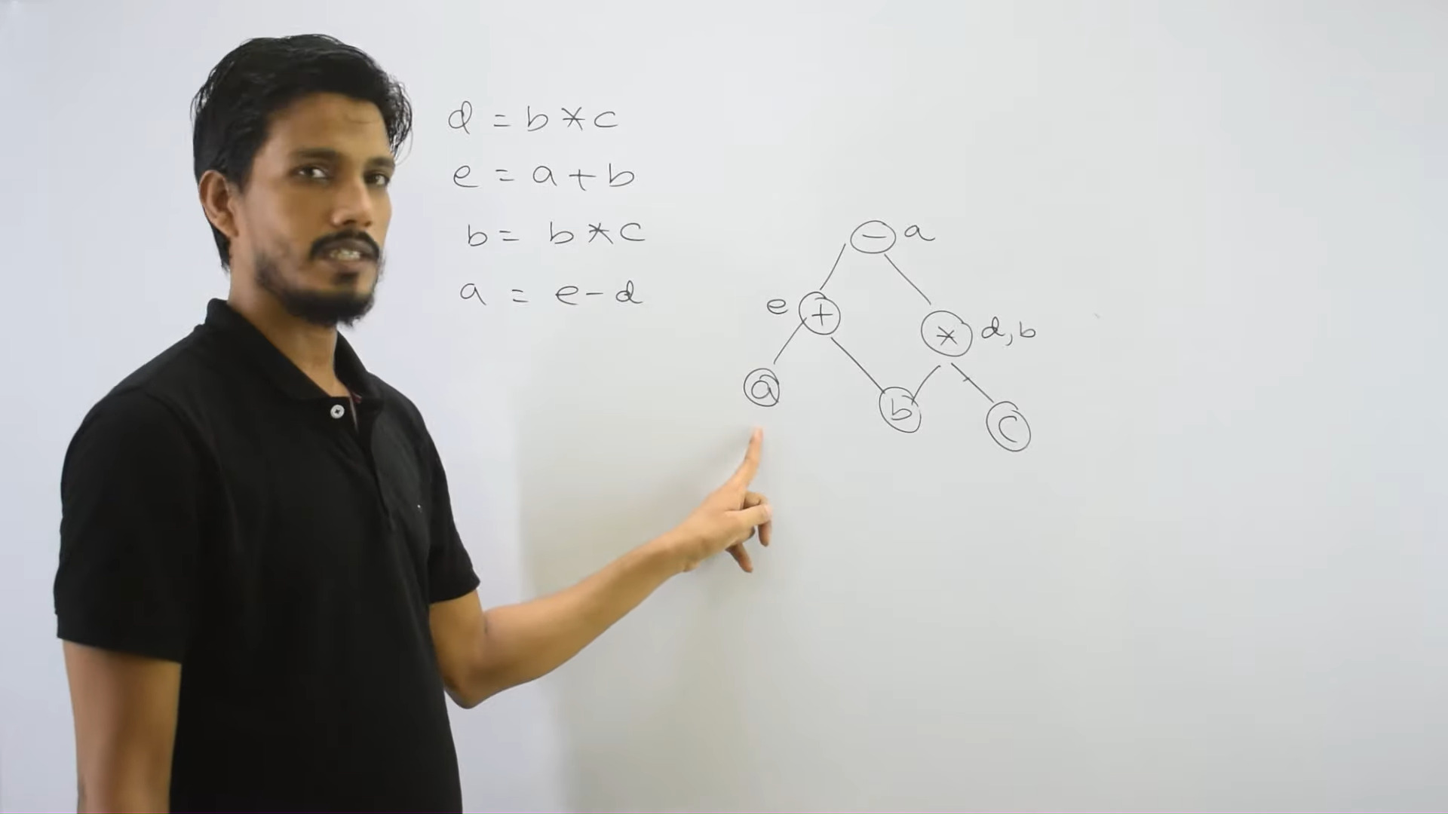

Slide 33
DAG
Construct the dag for the following expression
((x + y ) − ((x + y ) ∗ (x − y ))) + ((x + y ) ∗ (x − y ))
Intermediate Code Generation

Slide 34
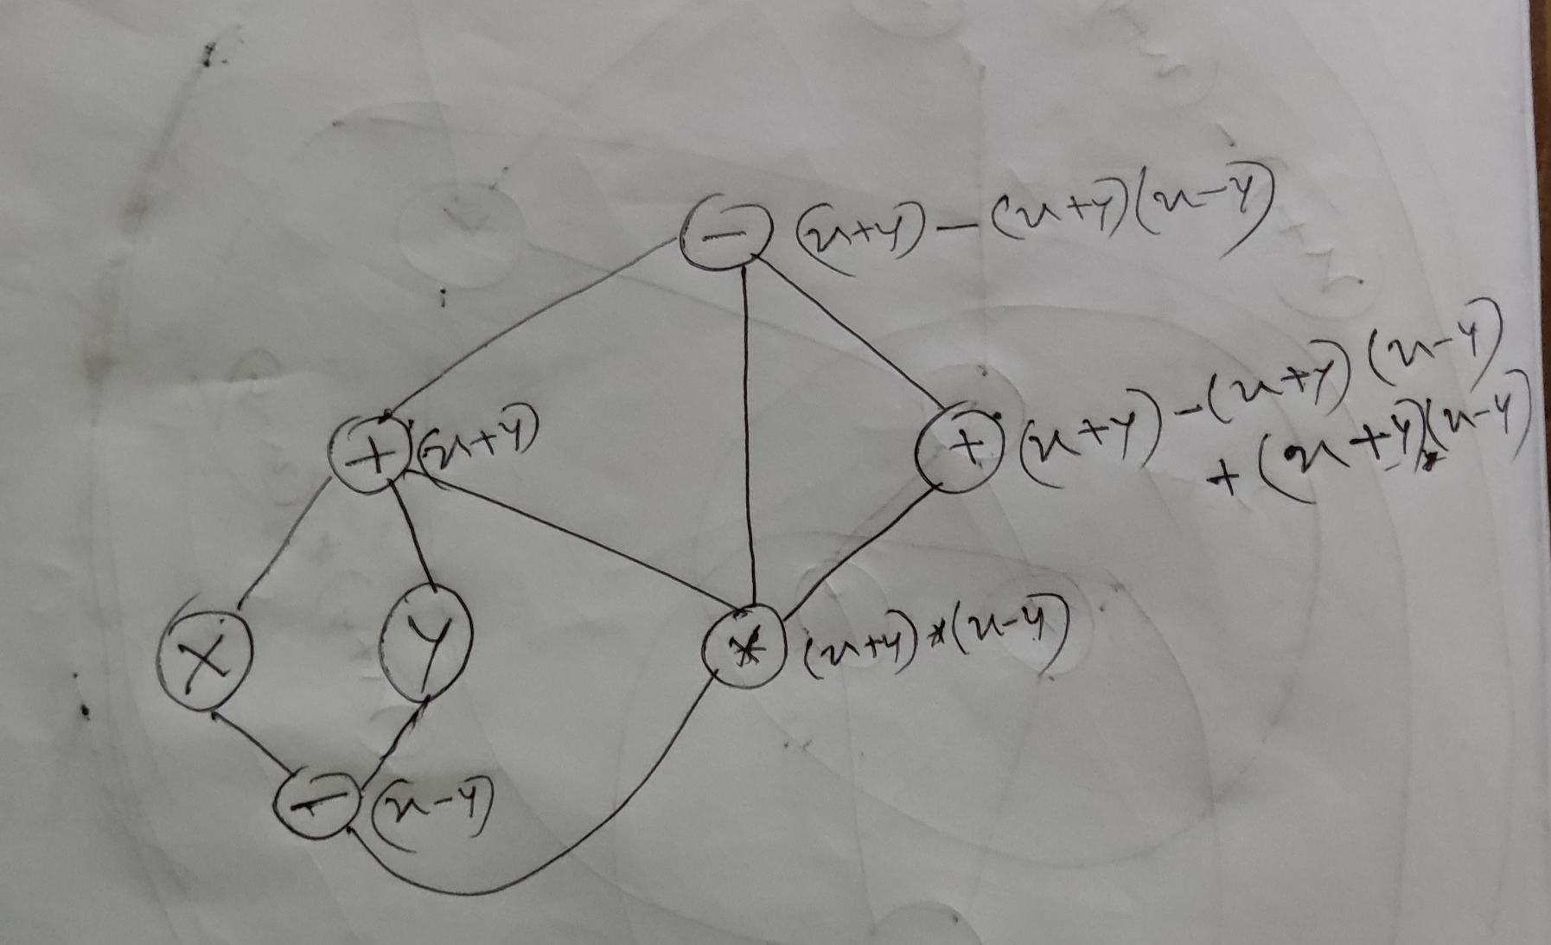

Slide 35
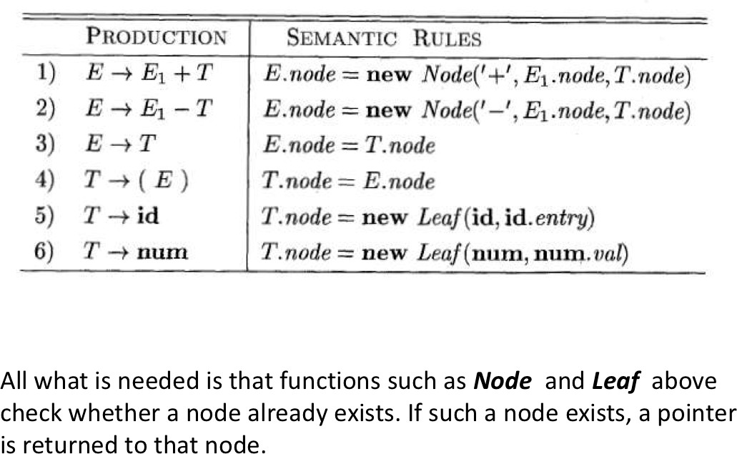
DAG from SDD
symbol table
Intermediate Code Generation

Slide 36
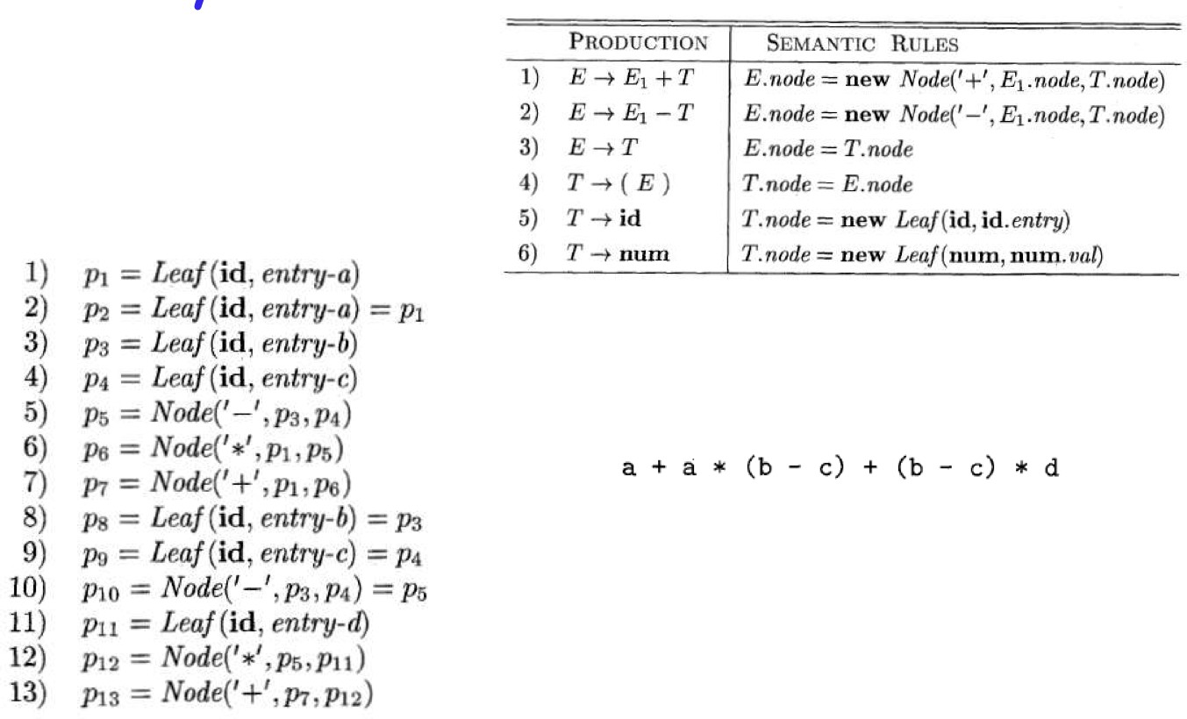
DAG from SDD
Intermediate Code Generation

Slide 37
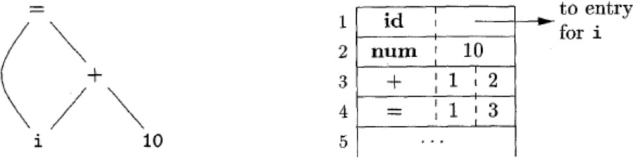
Data Structure: Array
Intermediate Code Generation

Slide 38

Data Structure: Array
Leaves
Left and right children of an intermediate node
Operation code
Intermediate Code Generation

Slide 39


Outline
1
Variants of Syntax Trees
2
Three Address Code
Intermediate Code Generation

Slide 40
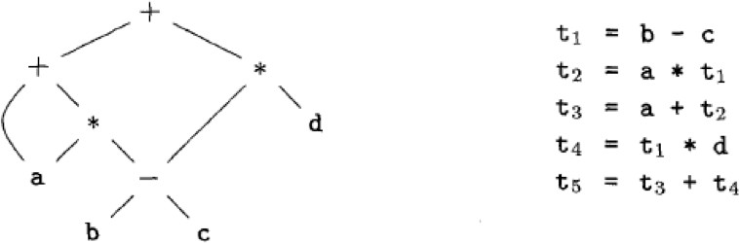
Three Address Code
Another option for intermediate presentation
Built from two concepts: addresses and instructions At most one operator
Intermediate Code Generation

Slide 41
Three Address Code
Address can be one of the following: A name: source program name A constant
Compiler-generated temporary
Intermediate Code Generation

Slide 42
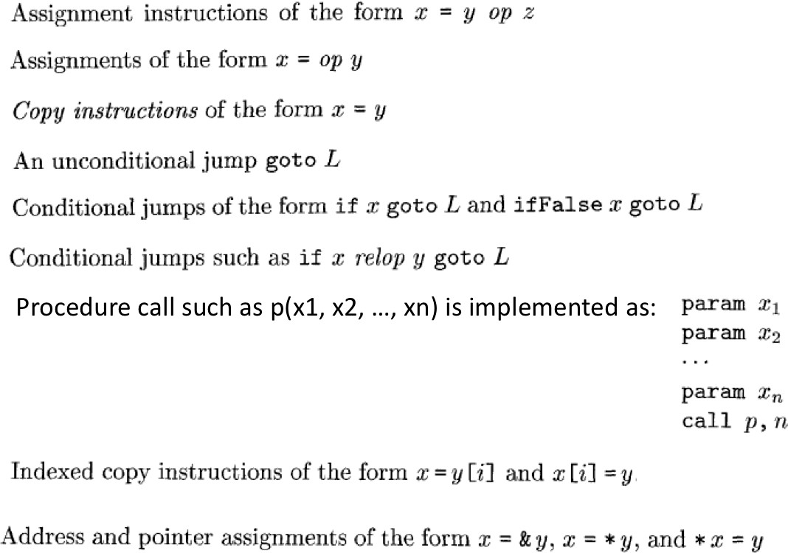
Instructions
if x relop y goto L
Intermediate Code Generation

Slide 43
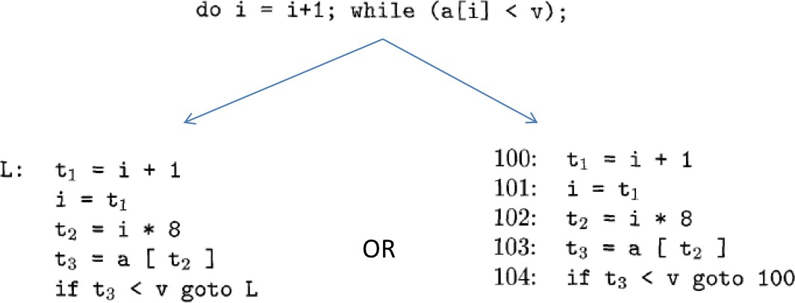
Example
Intermediate Code Generation

Slide 44
Choice of Operator Set
Rich enough to implement the operations of the source language
Close enough to machine instructions to simplify code generation
Intermediate Code Generation

Slide 45
Data Structure
How to present these instruction in a data structure
Quadruples
Triples Indirect triples
Intermediate Code Generation

Slide 46


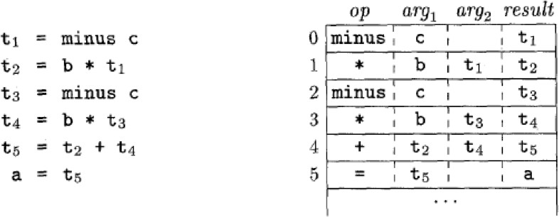
Quadruples
Has four fields: op, arg1, arg2 and result
Intermediate Code Generation

Slide 47
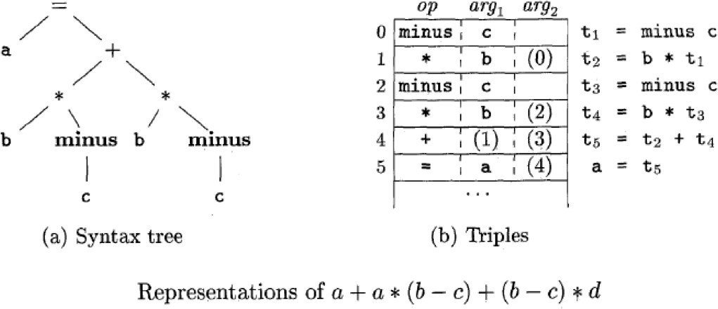


Temporaries are not used and instead references to instructions are made
Triples
Intermediate Code Generation

Slide 48
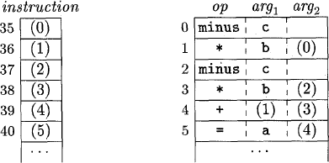
Indirect Triples
In addition to triples, a list of pointers to triples
Optimizing complier can reorder instruction
list, instead of affecting the triples themselves
List of pointers to triples
Intermediate Code Generation

Slide 49
Example
Intermediate Code Generation

